Slide 1
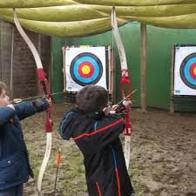
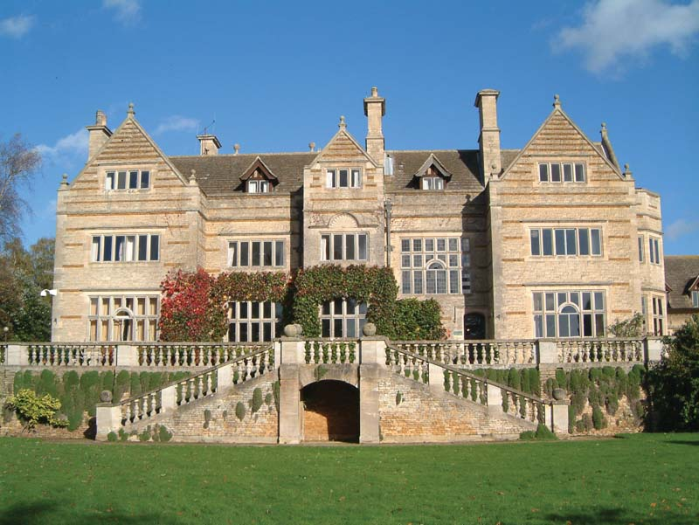
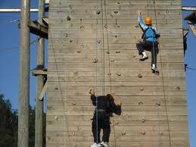
Year 6 Residential 2024 PGL Caythorpe Court Lincolnshire

Slide 2
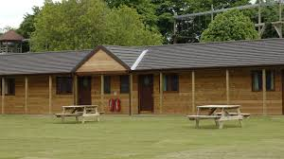
Caythorpe Court Accommodation
Rooms are all on ground level.
Adult rooms are spaced out between the children’s rooms
Adult rooms clearly marked so children know where to find us in if they need us at any time.
Children are guaranteed to be in a room with one friend of their choice
Children will be told
about rooms when we
arrive.
Notes:
The Fens are purpose built wooden lodges with en suite rooms sleeping 4-6.
The Vales comprise en suite rooms sleeping 4, 6 or 8
The Wolds comprise en suite rooms sleeping 4 - 8
Tents are spaciously sited and sleep 4 - 6 on frame mattresses. Toilets and showers are close by.

Slide 3
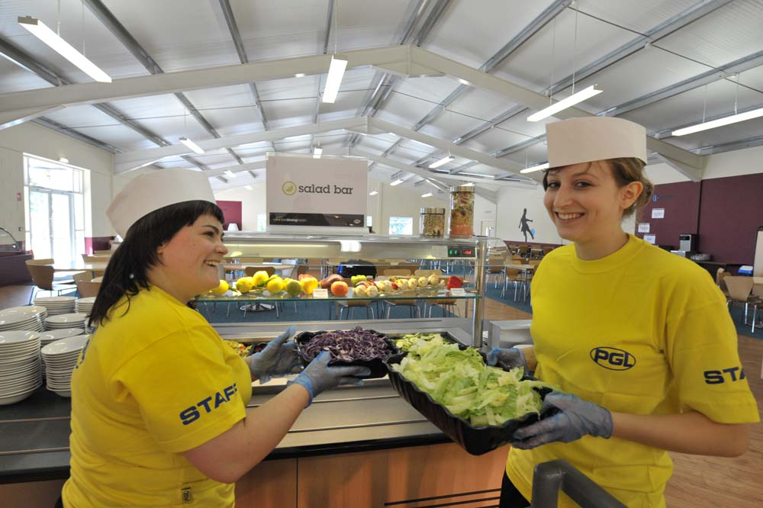
Catering & dietary needs
3 nutritious, balanced
meals per day
Vegetarian option
Salad bar
Special diets catered for –
Please advise us of this
(if you have not done so already on the form)
Freshly cooked
Processed food avoided
Notes:
Continual investment in healthy menus
Fresh ingredients fully traceable to audited suppliers
Freshly cooked
Processed food avoided
Meals meet Local Authority guidelines
Caterers can deal with most dietary requirements but please ensure the party leader is aware of any dietary requirements well in advance.

Slide 4
The proposed itinerary for the week..
Notes:
Continual investment in healthy menus
Fresh ingredients fully traceable to audited suppliers
Freshly cooked
Processed food avoided
Meals meet Local Authority guidelines
Caterers can deal with most dietary requirements but please ensure the party leader is aware of any dietary requirements well in advance.

Slide 5
Kit List
Kit list was sent out – there are more if you need them
Maximum £10 spending money
No aerosols please
No electronic games,
hair straighteners,
mobile phones
No need to send food!
Plenty of clothes for ALL
weathers!!
Notes:
Continual investment in healthy menus
Fresh ingredients fully traceable to audited suppliers
Freshly cooked
Processed food avoided
Meals meet Local Authority guidelines
Caterers can deal with most dietary requirements but please ensure the party leader is aware of any dietary requirements well in advance.

Slide 6
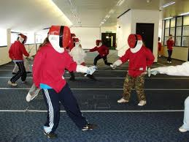
Medication
Staff will have a bottle of Calpol – if your child
needs it, they will call you for permission first.
Hayfever medications, inhalers, epi-pens or any other medication needs to be clearly labelled, with usage directions and given to Mrs Kendall.
Please make sure a medication form is completed for any medication that your child will need.
You can drop any medication for the trip into school the Friday before or on the Monday before we leave.
Notes:
Continual investment in healthy menus
Fresh ingredients fully traceable to audited suppliers
Freshly cooked
Processed food avoided
Meals meet Local Authority guidelines
Caterers can deal with most dietary requirements but please ensure the party leader is aware of any dietary requirements well in advance.

Slide 7
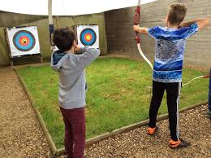
Monday 17th June Lets go!
Children will arrive to school at 8.45am with their suitcases.
Please make your way to the hall where the suitcases will be stored and any medication can be given to Mrs Kendall.
The coach will leave at 1pm You are welcome to come and wave us off.
Notes:
Continual investment in healthy menus
Fresh ingredients fully traceable to audited suppliers
Freshly cooked
Processed food avoided
Meals meet Local Authority guidelines
Caterers can deal with most dietary requirements but please ensure the party leader is aware of any dietary requirements well in advance.

Slide 8
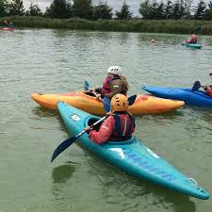
Friday 21st June Time to come home!
We are staying at the centre for lunch.
Due back into school at around 3.30pm.
Updates throughout the week via X (Twitter)
Notes:
Continual investment in healthy menus
Fresh ingredients fully traceable to audited suppliers
Freshly cooked
Processed food avoided
Meals meet Local Authority guidelines
Caterers can deal with most dietary requirements but please ensure the party leader is aware of any dietary requirements well in advance.

Slide 9
X (formally Twitter)
We will send pictures and keep you posted about the activities and how the children are doing on X….
If you need to contact anyone in an emergency, you can ring the school during school hours and we will ensure someone gets back to you.
Out of hours, Caythorpe Court’s direct number is: 01400 273733

