Slide 1
Welcome to Year Six
Mr Agnew, Mrs Honeywood, Mrs Rodriguez
Mrs Mayes - Mondays 6A
PPA – Mrs Willis (Tues AM – 6A/Tues PM – 6H)

Slide 2
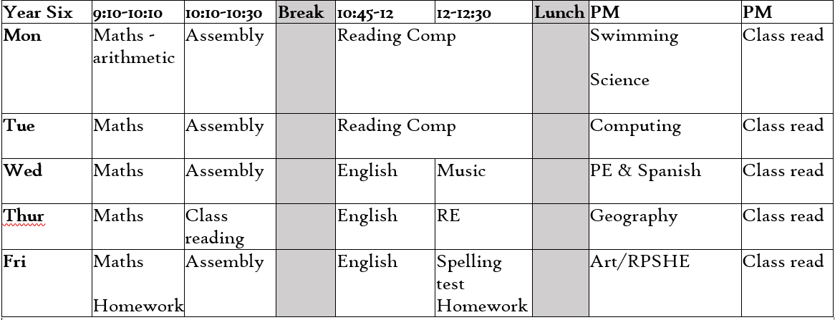
Timetable

Slide 3
Maths and English
English
Daily lessons
Fiction and Non-fiction genres
Writing is meaningful
Sets – taken from baseline assessments
Maths
Daily lessons
Mental arithmetic
Methods
Reasoning
Sets – taken from baseline assessments

Slide 4
Reading Books
The most important part of reading is to gain fluency and automaticity.
Children will read with an adult 1 x a term
Reading books are matched to fluency and are there for practise not challenge, even those who are a free reader
Reading recognition
KS2 Reading Spine
Library bus – reading for pleasure

Slide 5
Spellings
Spelling
Year Six will be starting on the Y5/6 statutory word list.
Spelling patterns and investigations will take place next term.
Expectation that children can apply spelling knowledge into everyday writing.

Slide 6
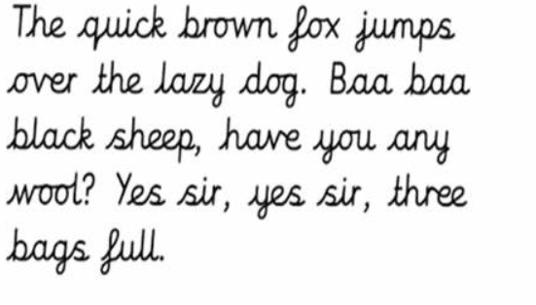
Cursive Handwriting and presentation

Slide 7
Curriculum
Fun, Creativity, Achievement
Term 1 – Rule The World
Term 2 – Vietnam War
Term 3 – Vietnam (continued)
Term 4 – A Peaceful Protest
Term 5 – Our World, Our Future
Term 6 – I Have A Dream

Slide 8
PE
PE day is a Wednesday
Indoor and Outdoor sessions
PE kit – refer to the website for the kit details. Children to come into school in their kit on their PE day.
No earrings or jewellery.

Slide 9
Homework
SPaG, Spelling & Maths homework will be given out every Friday to be due in the following Wednesday.
We will run through the homework every Friday (and conduct a spelling test) before handing out new homework.
Reading expectation – 5 times a week.

Slide 10
Expectations
School values: caring, self-discipline, resilience, respect, aspiration, cooperation
Behaviour: opt-in approach
Uniform

Slide 11
Exciting things to come
Christmas Production
Values Rewards
Trips
Residential

Slide 12
Meetings to follow
Parent Workshops
Maths – completed – PowerPoint will be available on website
Reading – 26th September, 6pm
SPAG – 3rd October, 6pm
Please come and ask if you have any questions before a workshop or parents’ evening.

Slide 13
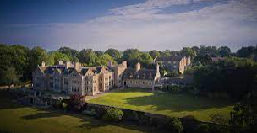
Residential 2024
Caythorpe Manor PGL - Lincolnshire
Monday 17th June – Friday 21st June

Slide 14
Residential 2024
Payments
Fist initial deposit payment due by 06.10.23
Our office staff have set up a payment portal which has been emailed out.
Payments can be made as frequently as needed.

Slide 15
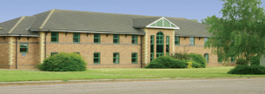
Accommodation
Rooms tend to be split over 2/3 floors
Adults rooms on both floors
Adult rooms are clearly marked so children know where to find us should they need us.
Key-coded main doors
Children are guaranteed to be in a room with at least one friend of their choice

Slide 16
Catering
3 nutritious balanced meals per day
Vegetarian options
Salad bar
Special diets are catered for
All food is freshly cooked on-site
Processed foods are avoided

Slide 17
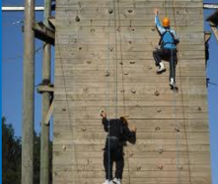
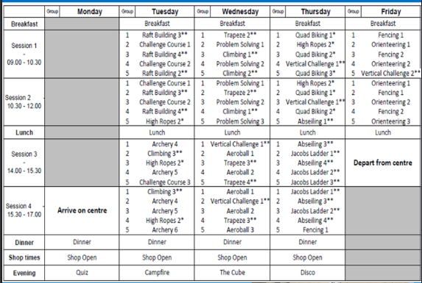
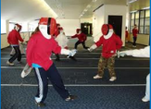
Daily Schedule

Slide 18
Medication
Staff will be provided with any daily medication and instructions before we leave and will always be kept in staff area (inhalers etc. may be an exception)
Staff will also have Calpol on-site – if your child needs it, we will call for permission first
Hayfever medications, inhalers, epi-pens or any other medication needs to be clearly labelled, with usage directions and given to Mrs. Kendall (morning of departure or the Friday before we leave)

Slide 19
Kit List
Please take one before you leave

Slide 20
Any questions?

