Slide 1
Welcome to Year 3
Mrs Patel, Mr Robinson, Mrs Bromwell.
PPA staff: Mrs Charters (Tuesday pm) Mrs Andrews (Wednesday pm)

Slide 2
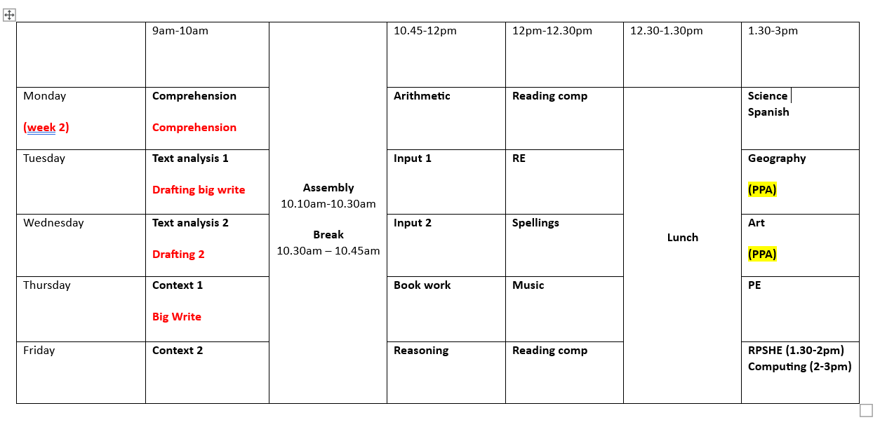
Timetable
School start time: 8.45am
Learning begins straight away.
These timings can sometimes change.

Slide 3
Maths and English
English
Daily lessons
Fiction and Non-fiction genres
Writing is meaningful
Maths
Daily lessons
Mental arithmetic
Methods
Reasoning
The children will be set for maths into two groups which we feel will benefit the children the most. They will also be split for comprehension once a week, however all writing lessons will remain in classes.

Slide 4
Reading Books
The most important part of reading is to gain fluency and automaticity
KS2 – Children will read with an adult 1 x a term
Reading books are matched to fluency and are therefore for practise not challenge, even those who are a free reader
Reading rewards system has changed this year to a ‘Reading Recognition Scheme’. The children will have a sheet stuck in the front of their journal which should be ticked each day your child has read. We will not be collecting the number of pages or time read anymore. The children will be rewarded with a certificate at each milestone followed by a badge for 200 days read and a visit to the vending machine for 250+ days read.
KS2 Reading Challenge – coming soon . This is where children can select can a book from the reading spine and after reading it, if they complete a review they can earn a visit to the vending machine.
Library bus – reading for pleasure

Slide 5
Spellings
Spelling
In Year 3, the children will get a spelling investigation according to the spelling pattern we are looking at that week. The following week, the children will get 5 seen words to take home to practise. They will then be tested with 5 seen and 5 unseen words within the same pattern.
The expectation at home is to learn the spellings and transfer their spelling knowledge into their writing.

Slide 6
Cursive Handwriting and presentation
In Year 3, the children will continue to be writing with a cursive style.
It is important that they start their letters in the correct place and that the orientation and sizing is consistent.
Presentation is important in all subjects – we want the children to have a sense of pride in their work and we know they worked hard on this in Year 2.

Slide 7
Curriculum
Our lessons link to our ethos, Fun, Creativity and achievement, therefore a mixture of approaches will be taken for each lesson. They will not all be written lessons and will include a very practical approach so that the children are able to experience different aspects of our curriculum.

Slide 8
PE
PE day is a Thursday
Indoors and Outdoor sessions
PE kit – refer to the website for the kit details. Children to come into school in their kit on their PE day.
No earrings or jewellery

Slide 9
Homework
Homework will be given out every Friday. This will consist of a spelling investigation and Maths one week, followed by 5 seen spellings and SPAG the week after.
Reading homework expectation is 5 x week, additional to the above.

Slide 10
Expectations
Values – to promote the school values the children can earn gems which in turn means they work collectively towards a class reward
Behaviour
Uniform
100% engagement - consistent language 3,2,1

Slide 11
Exciting things to come
- Curriculum days
- We will be booking in some trips and visitors based on our topics in the months to come.
Class Assembly – The children will create a class assembly as a year group and perform.
Parent Workshops
Maths Workshop for Parents - Tuesday 19th September
Reading Workshop for Parents – Tuesday 26th September
SPAG Workshop for Parents – Tuesday 3rd October

Slide 12
Any questions?

