Slide 1
Welcome to Year 1
Mrs Chapman (1C)
Miss Knott (1K)
Mrs Waddington and Mrs Andrews
Mrs Waddington will be teaching all day in 1K every Monday and every Wednesday and Friday afternoon in 1C.

Slide 2
Timetable
Doors open at 8:45am, the register is taken promptly at 9am. If you arrive after 9am please take
your child to the office.
End of the day is 3:15pm – if someone different is collecting your child, please inform one of the
adults in your child's class.

Slide 3
Maths and English
English
Build upon the foundations that have been learnt in Reception.
Begin to introduce more complex sentence structure and SPAG.
E.g. adjectives, verbs, expanded noun phrases, conjunctions ! ?
Building up the children’s writing stamina.
Fiction and Non-fiction genres are covered throughout the year.
Maths
Begin with a focus on 1 to 1 correspondence (counting), number recognition, number composition and number patterns.
All new topics are introduced practically with resources before moving onto the abstract concept.
Lessons are pacey, lots of opportunities for paired talk with no set groupings. Everyone is challenged to the best of their ability.

Slide 4
Phonics
Follows the Essential Letters and Sounds (ELS) scheme.
Taught daily as a whole class.
Children learn phase 5 sounds and alternative sounds.
Phonics Screening Check
The phonics screening was introduced eleven years ago by the government. It is designed to further inform our continual assessment of the children’s phonic knowledge and the results of the check will be shared with parents/carers in the end of year report.
It comprises of a list of 40 words that children read one-to-one with a teacher. The list is a combination of both real and made up, non-words which rely purely on using phonics to decode. The non-words are words that have been made up and will be shown with a picture of an imaginary creature (alien) to help them.

Slide 5
Reading Books
Reading is at the heart of the curriculum at Preston Hedge’s.
Our aspiration is for every child to be able to read fluently and enjoy reading.
Reading books match their fluency not their phonics knowledge.
Reading books are for practise not challenge.
The most important part of reading is to gain fluency and automaticity.
Your child may come home with the same reading book, but this is to consolidate their reading skills to enable them to become fluent readers.
Library session every Monday morning – children can go to the library bus and change their library book. Please remember to bring your library book back to exchange for a new one.

Slide 6
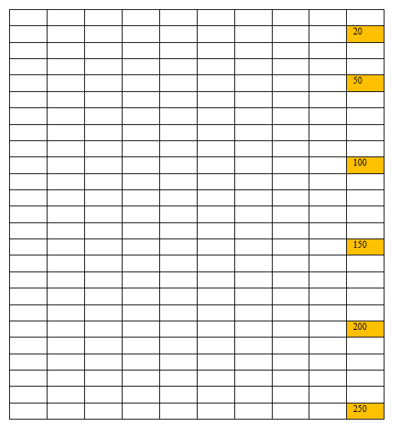
Reading Recognition
Each day your child reads their reading scheme book to an adult at home, please sign and date their journal and then tick the grid at the front. One tick per day read. We can then issue the reading recognition certificates and badge accordingly.
20 days – Bronze Certificate
50 days – Silver Certificate
100 days – Gold Certificate
150 days – Platinum Certificate
200 days – Reading Award Badge
250+ days – Vending Machine Visit

Slide 7
Spellings
New spellings will be sent home on a Monday with a spelling test taking place the following Monday.
Most children will bring home 8 spellings to learn; focusing on a particular sound
e.g. the ‘ay’ sound (play, say, bay)
Surprise spellings – the children will also be tested on 2 surprise spellings (focusing on the same sound)
First spellings will be coming home on Monday 18th September
Spellings will be stuck inside the children’s reading journals each Monday. An electronic copy will also be uploaded to seesaw -your child will come home with an individual login for this next week.

Slide 8
Cursive Handwriting
Cursive is a handwriting style where all letters have an entry stroke which means letters always start from the same place.
Letters are produced in a flowing movement, which helps the development of a physical memory of how each letter is written.
Letters all start in the same place and flow from left to right, which reduces the likelihood of reversal mix-ups such as b/d and p/q.
Because of the smooth flow, writing soon becomes quicker and easier.
There is no messy transition stage when children move from print to a joined style. If cursive writing is taught from the start, only one style is needed.
The children have opportunities in class to practise their handwriting everyday.

Slide 9
Curriculum
Over the year we cover 6 topics, alternating between Geography and History.
All lessons are planned with our ethos in mind; Fun, Creativity and achievement.
Year 1 Topics:
Term 1 – The World Around Us
(Local Geography including habitats)
Term 2 - The Tudors: Henry VIII
Term 3 - This Sceptred Isle
(Geography including Human and Physical Comparisons)
Term 4 - The Elizabethans
Term 5 - Poles Apart
(Environmental Geography)
Term 6 - The Victorians

Slide 10
PE
Our PE day is a Friday
Indoors and Outdoor sessions
PE kit – refer to the website for the kit details.
Children to come into school in their kit on their PE day.
No earrings or jewellery

Slide 11
Big Outdoors
Big Outdoors continues in Year 1, taught by Mrs Waddington.
1K – Monday pm
1C – Wednesday pm
Please ensure your child has brought in their labelled all in one suit and wellington boots. These will stay at school ready for each session.
Hot chocolate – if your child has any allergies please speak to your class teacher.

Slide 12
Homework
New spellings sent home every Monday.
2 reading books sent home per week
.
Children should be reading at home to an adult 5 x a week.

Slide 13
How You Can Help Us
Children to read at home every day with a grown up.
Ensure reading books come into school everyday along with their reading journal.
Correct uniform and school shoes.
School PE kits and trainers on PE day.
Label EVERYTHING!!
1 small keyring only on book bags.

Slide 14
Exciting things to come
Salcey Forest school trip – date tbc
Campfire celebration afternoon – Friday 20th October
Christmas Service – tbc
Year 1 class assembly – tbc
Maths Parent Workshop – 19th September Reading Parent Workshop – 26th September
SPAG Parent Workshop – 3rd October

Slide 15
Any questions?

