Slide 1
Times Table Rockstars

Slide 2
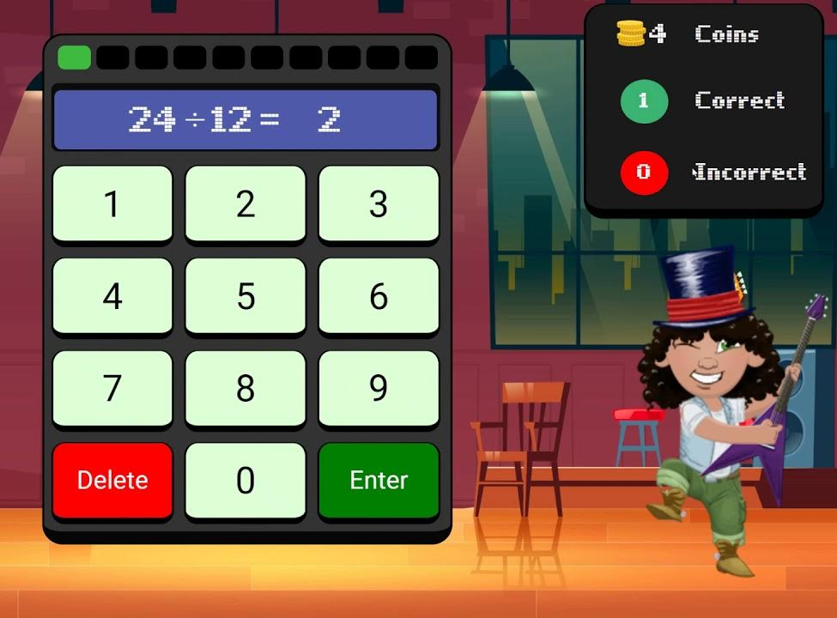
Jamming Mode
Division, but children can change to multiply by clicking invert

Slide 3
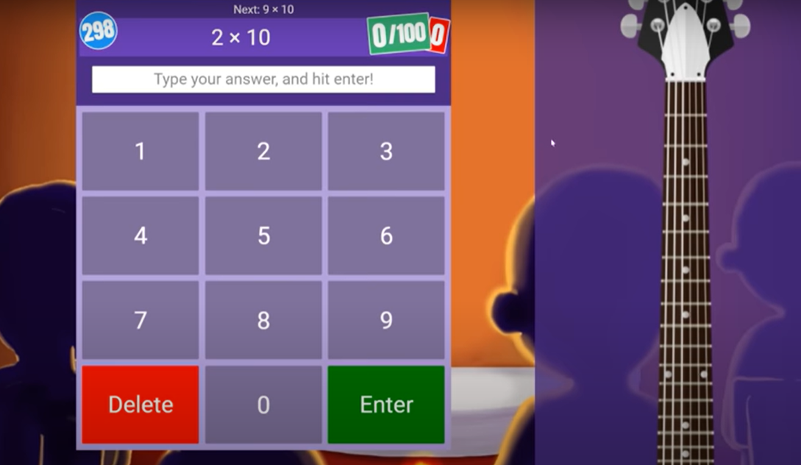
Gig Mode – available on the 1st of the month
Children have up to 5 minutes to answer as many questions as they can. There is no time limit for each question.
This shows teachers what they are able to do and the ones they need to practise

Slide 4
Garage Mode – highly rewarding in terms of coins
Opportunity to practise children’s times tables to improve their gig score
Some year groups, the times tables will be set rather than all of them being available

Slide 5
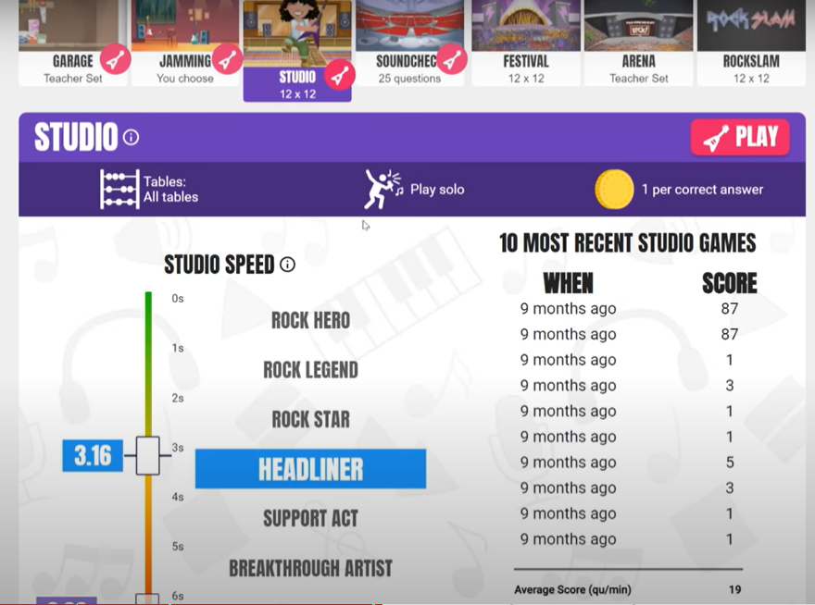
Studio Mode
Play in the Studio and answer 12 questions (all times table tables)
This is where they will earn a Studio Speed and a Rock Status.
They have to play 10 Studio games to earn their first Rock Status.
They can return to the Studio at any time to improve their Studio Speed and Rock Status
Each game is 1 minute and they need to answer as many multiplication and division questions as possible

Slide 6
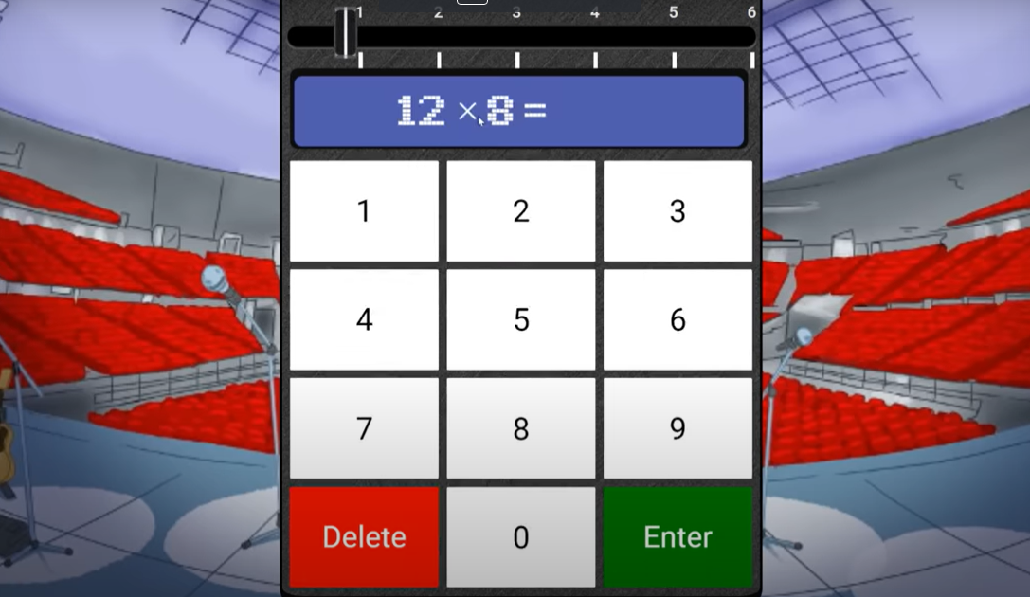
Sound Check Mode
25 questions
6 seconds for each question
Try not to press Enter!
Aim is to get as many correct as they can

Slide 7
Festival
The Festival is where they can take on other students from all around the world, answering any question up to 12 × 12. Each multiplayer Festival game is one minute long and they can earn 1 coin per correct answer.

Slide 8
Arena
The Arena is a multiplayer game where they can compete live against other children in their class. Like Garage, specific tables can be turned off by the teacher

Slide 9
Rock Slam
A Rock Slam allows a you to challenge someone from their class, year group or school (either a pupil or a teacher), setting a time for the challengee to beat.
When the challengee logs in, they'll be able to play against the challenger's 'ghost' in a head-to-head Rock Slam!

Slide 10
TT Rockstars – Battles and Awards
Battles will be set throughout the year. .
When children log on they will see if there is an active battle and also if one is coming up.
Awards
Certificates will be given out in some celebration assemblies. These will be based on different variables: e.g. speed, number of correct answers, minutes played etc.

